Slide 1


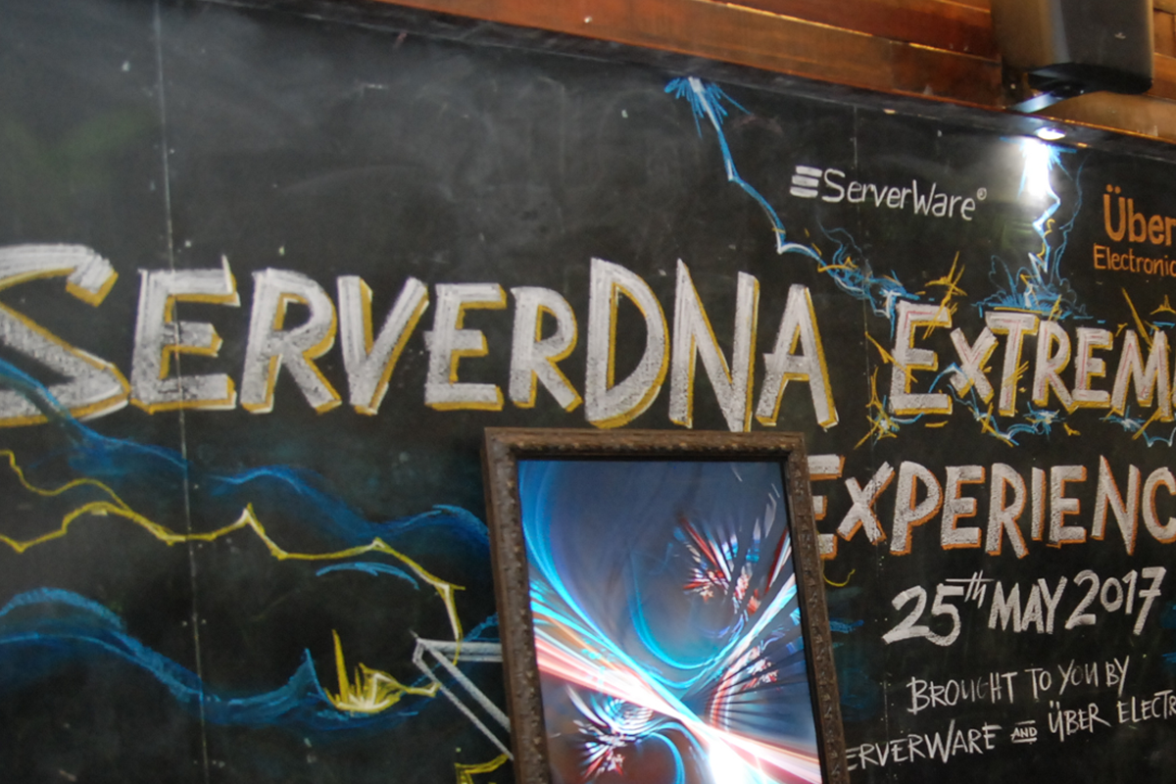

Draft Proposal.
V1

Slide 2
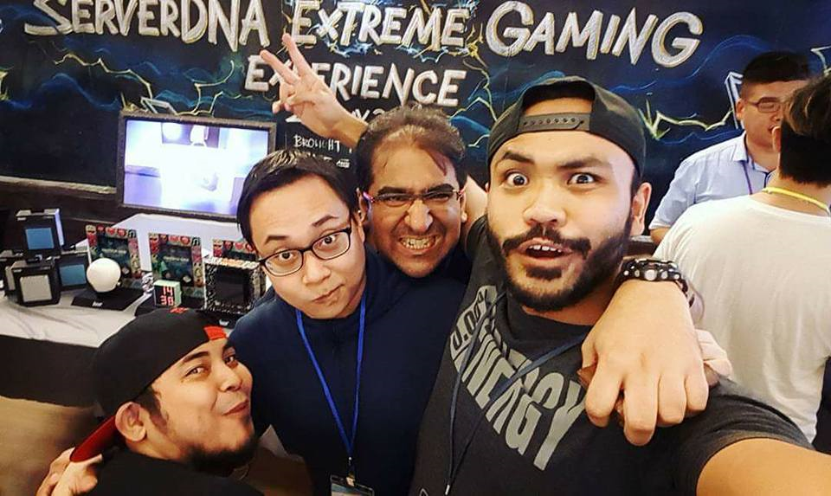
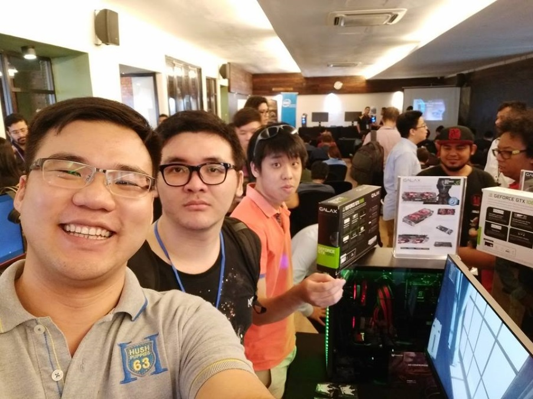
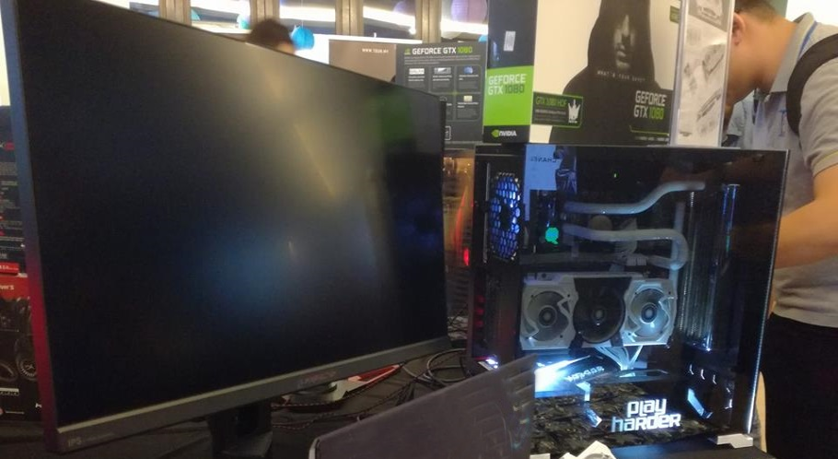
The serverDNA II Event is the single largest technology sharing conference
in the gaming community.
Where the gamers community meets and network with
technology owners.

Slide 3
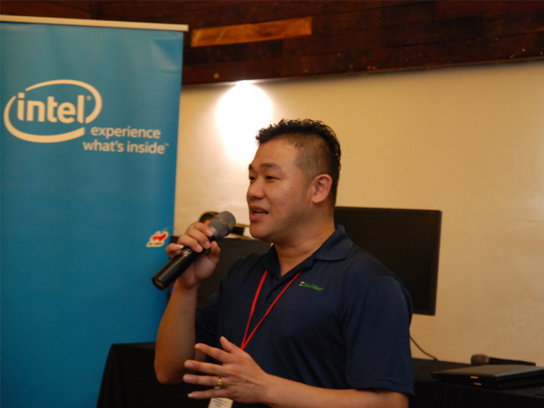
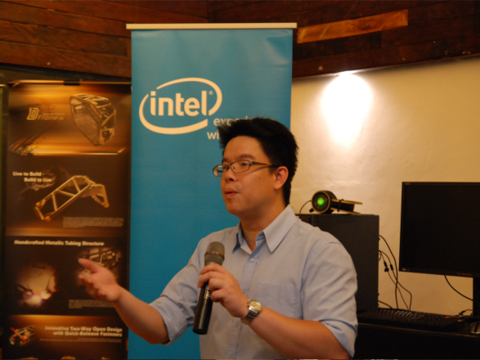
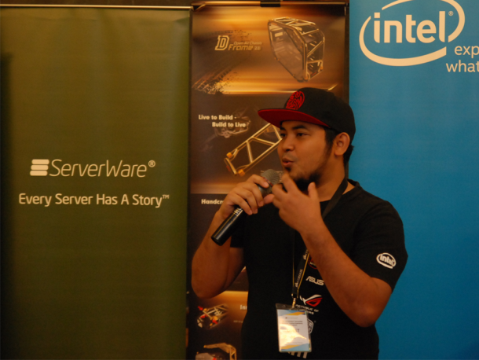
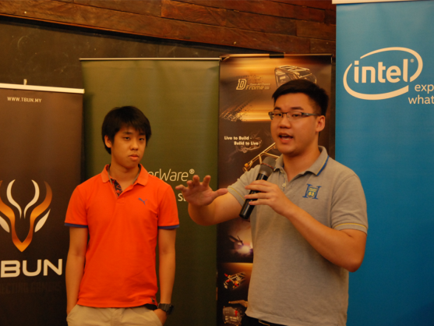
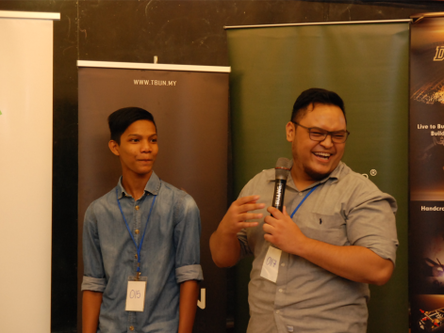
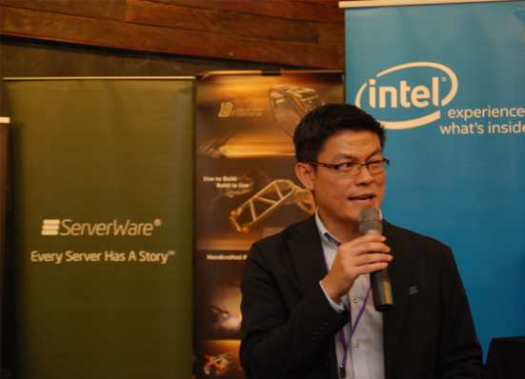
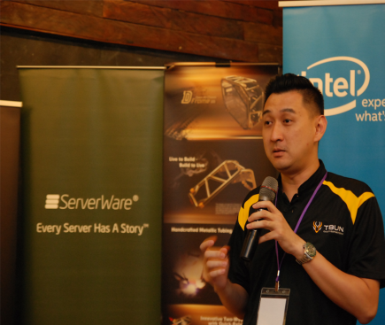
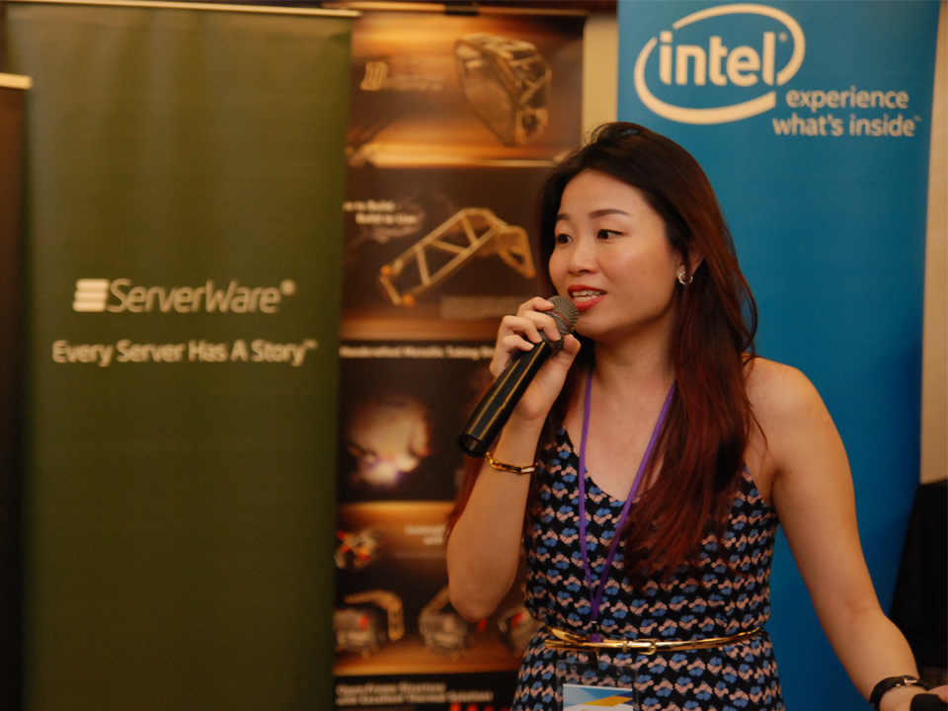
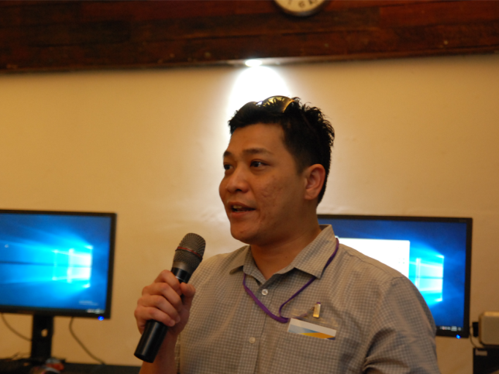
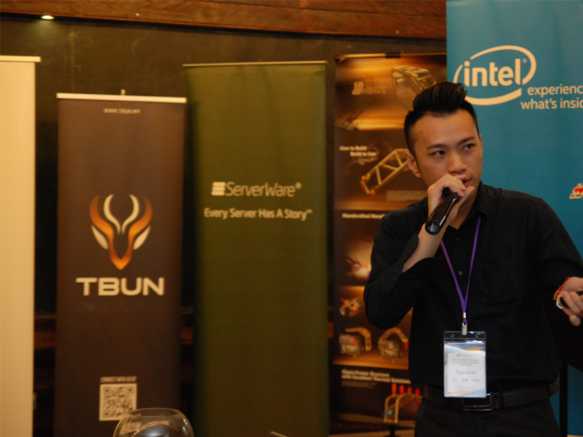
Cross Sharing between Technology Brands and the Gamers Community

Slide 4
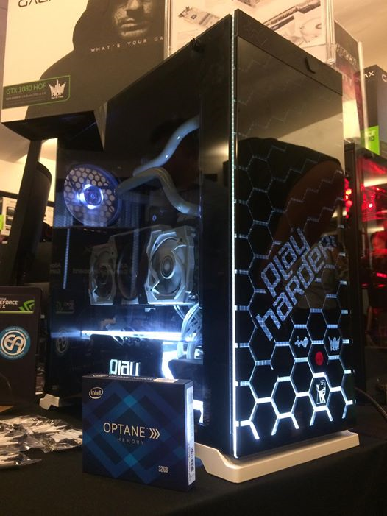
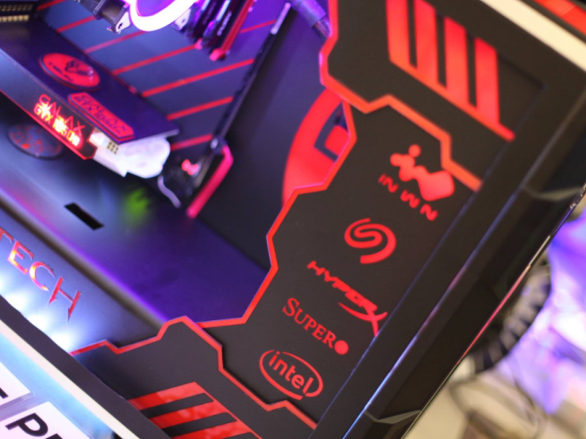
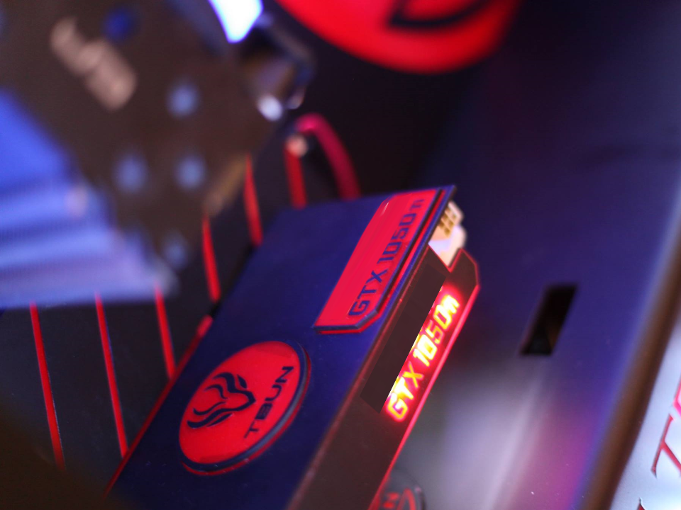
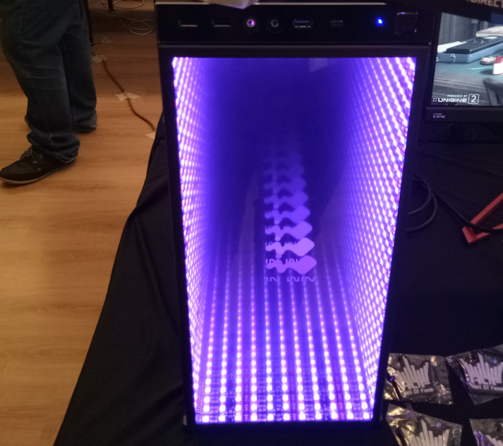
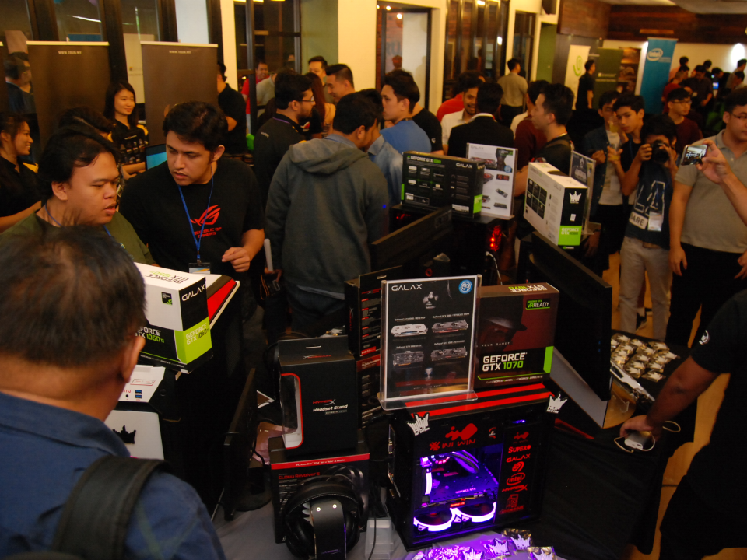
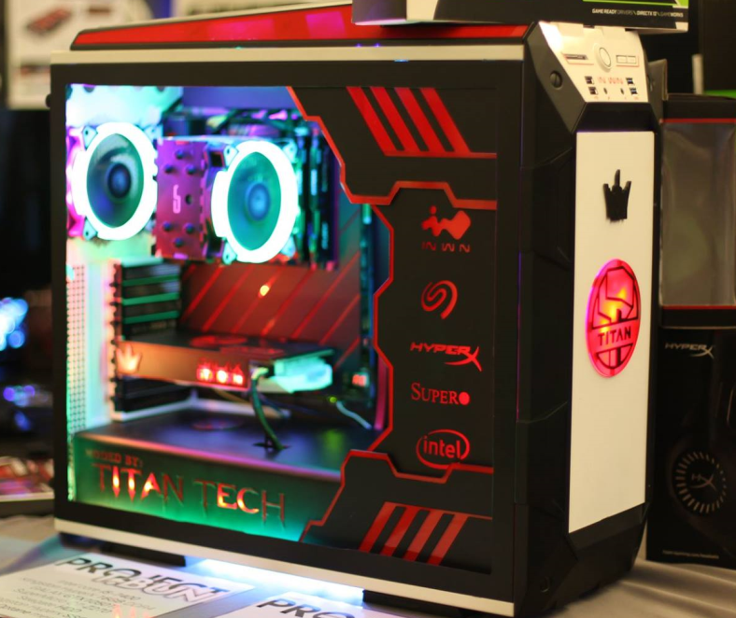
Community Creative
MasterClass PC Modding
Showcase

Slide 5







Top Class Technology Presenters

Slide 6
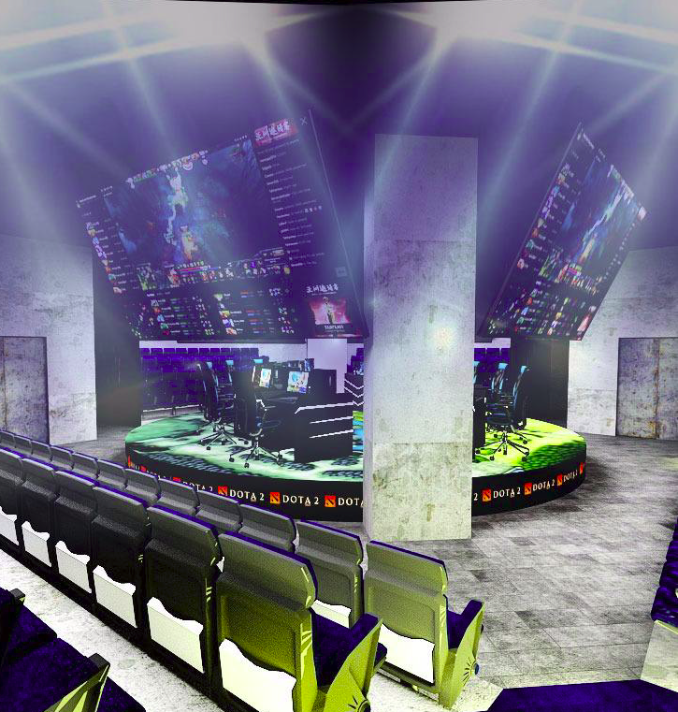
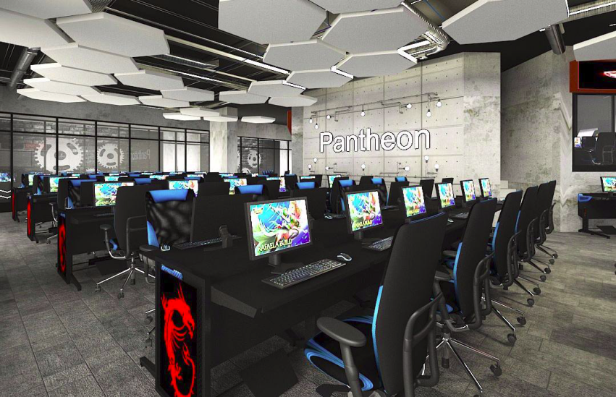

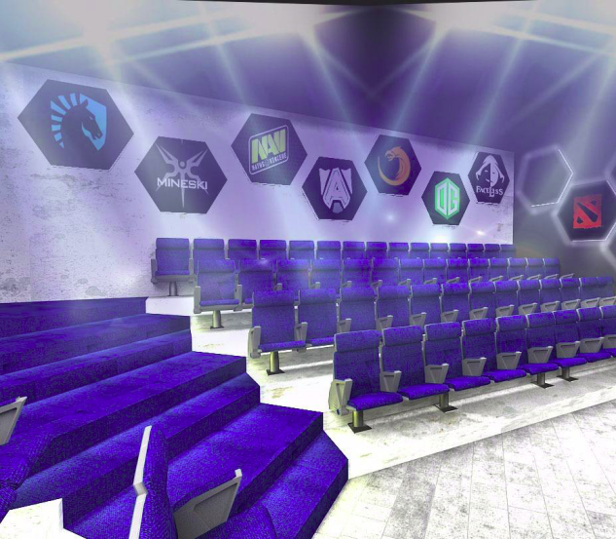
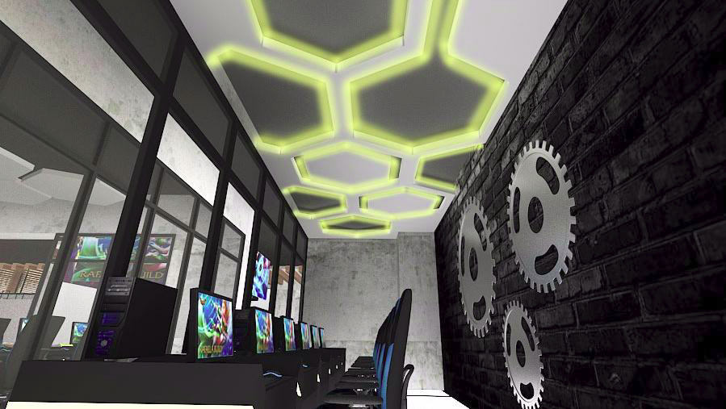
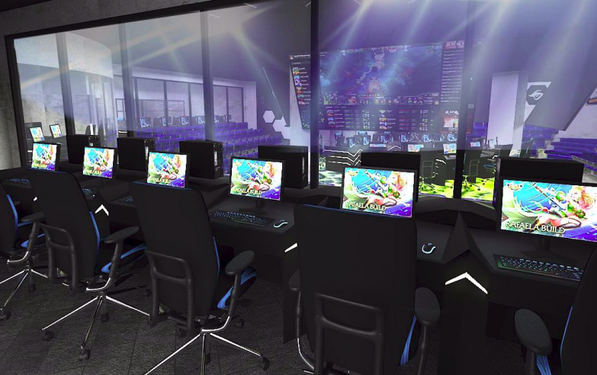
Arena Introductory showcase
The next generation eSports & gamers experience

Slide 7



EsPORTS Team Community
Meet & Greet
Up close & Personal with the leading
Malaysia eSports Team

Slide 8



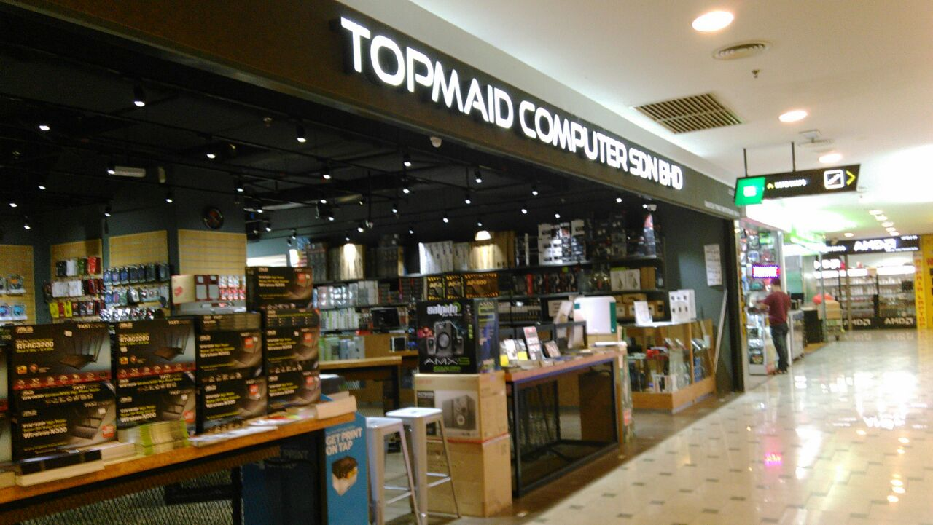



Custom Build PC Gamers Rig
with Markets Top Sellers

Slide 9
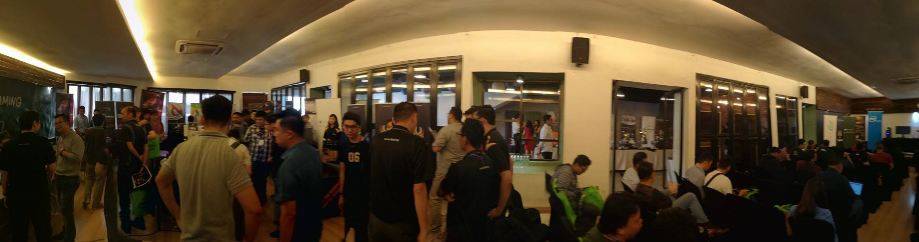
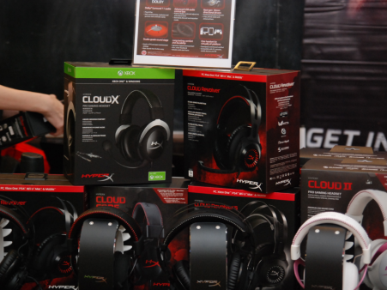
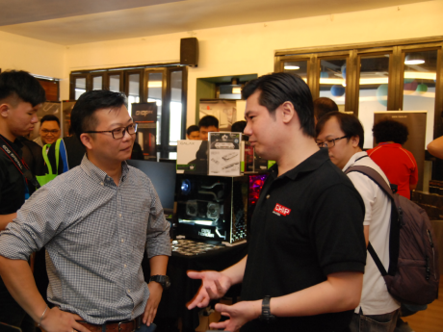
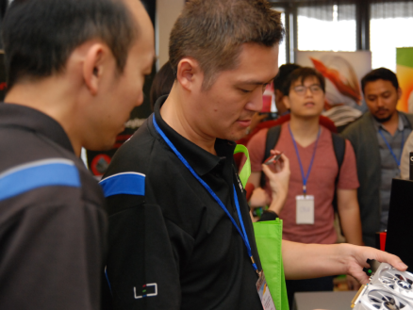
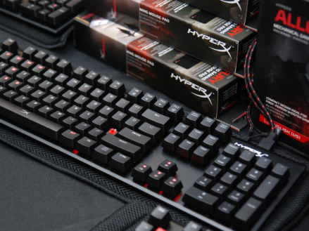
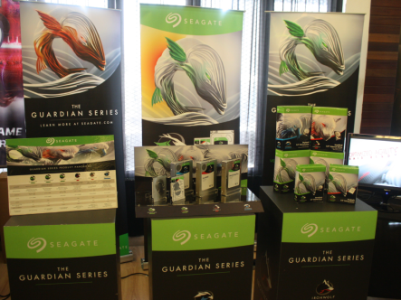
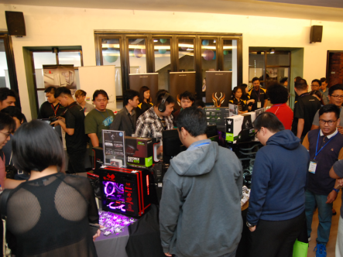
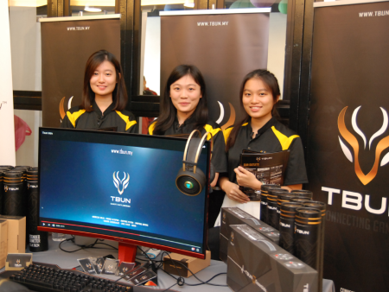
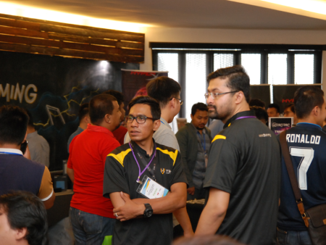
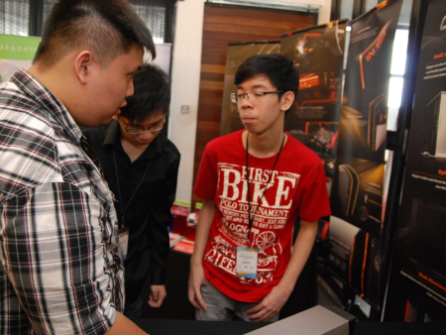
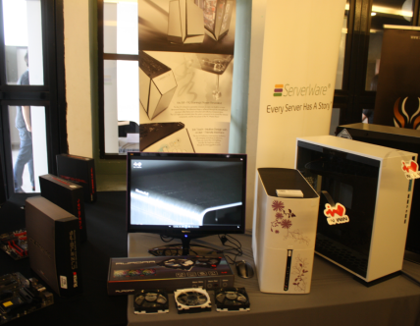
Technology Brand Showcase.
Leading the latest Gaming Technology to the community

Slide 10

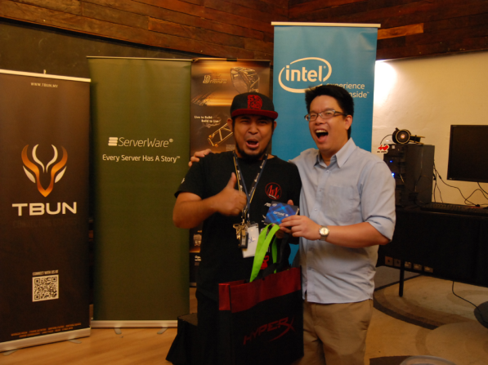
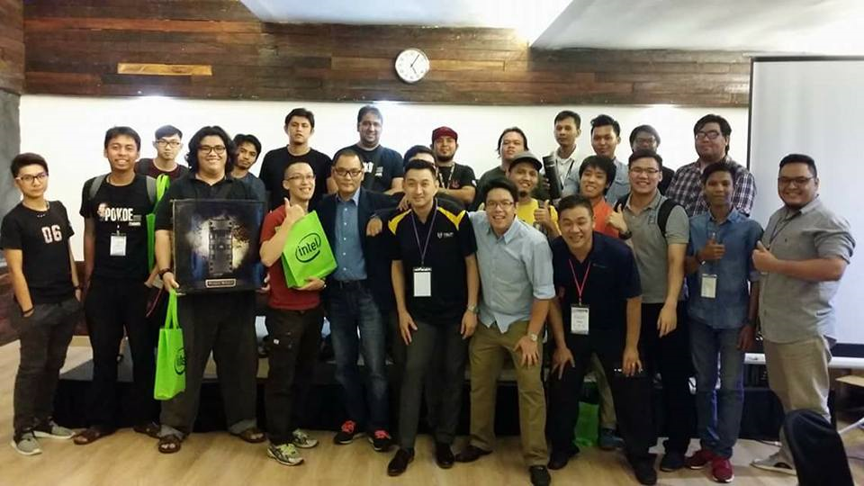
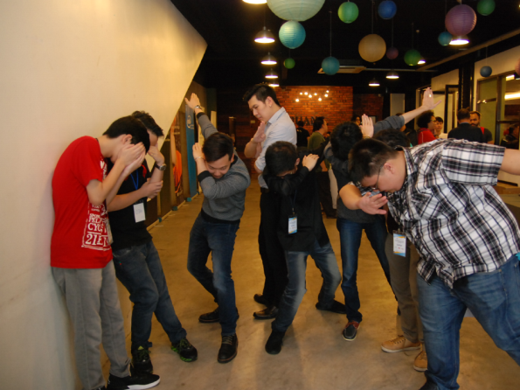
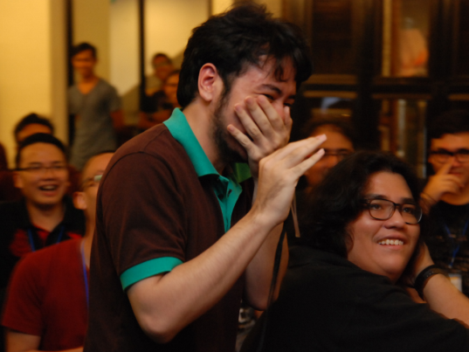
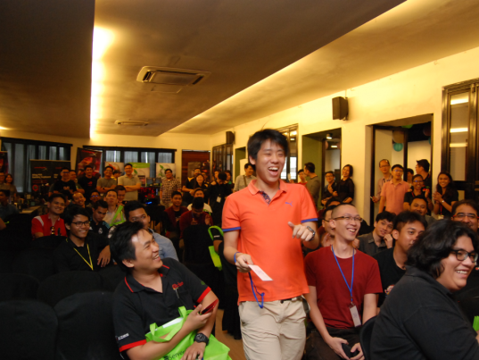
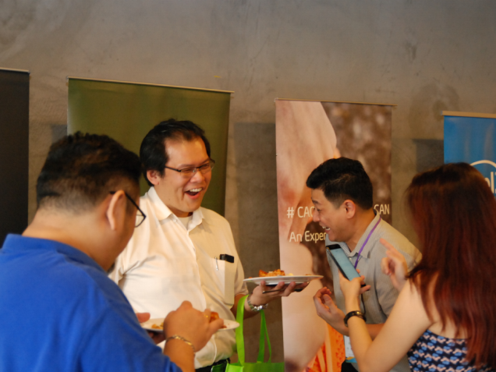
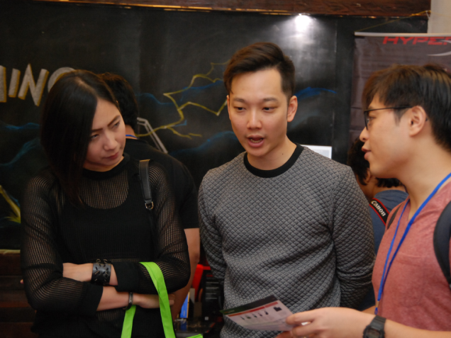
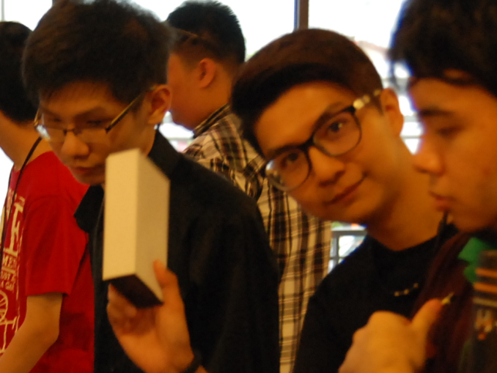
Building Community Growth
Through Sharing & Networking

Slide 11
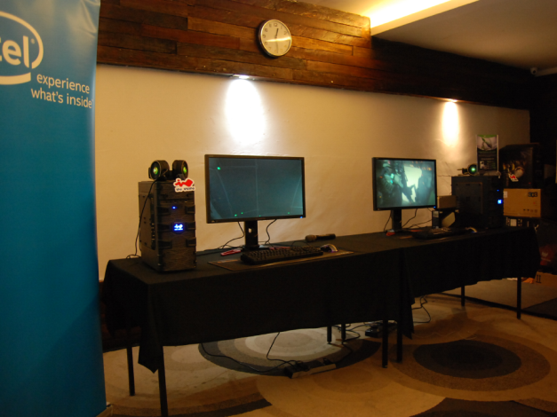
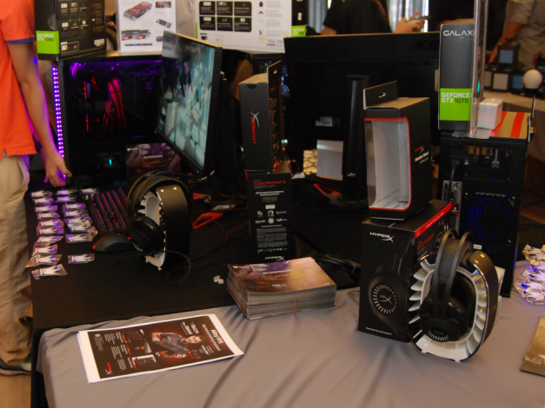
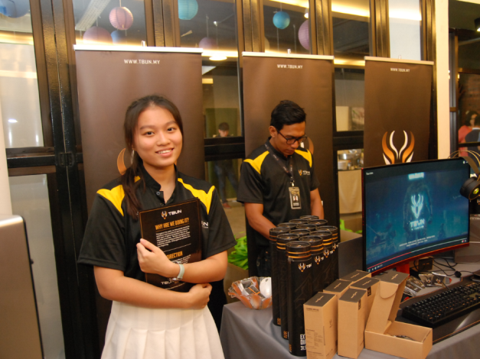
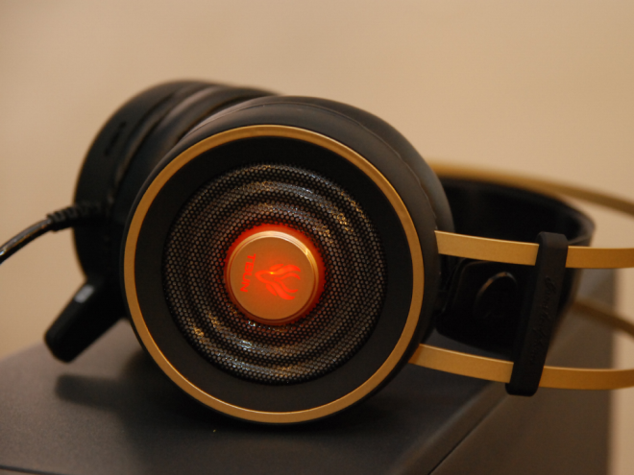
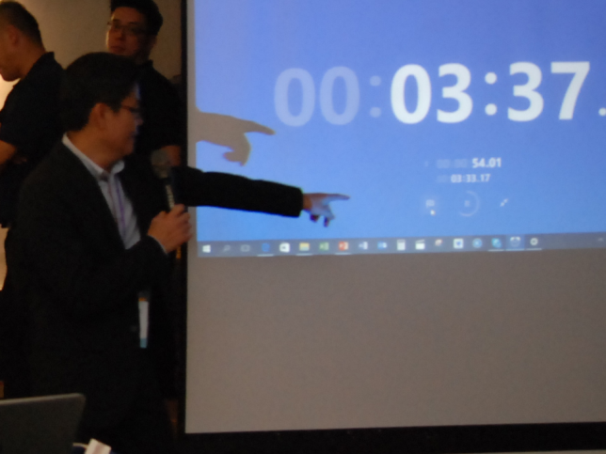
Technology Download
and Demos.
Learning FirstHand
Whats Good & Whats Not

Slide 12












The Fun & Games.
Interaction with the community thru
lucky draws and auction bids.
Win Win Sessions

Slide 13
Main Sponsor Ship Packages
Afternoon Sponsorship – RM 15,000
4 spots only
Ballroom Showcase 2 Table
Exclusive Product Category Showcase
(No 2 brands for same category)
(Memory and Peripherals are considered as 2 categories)
Meet & Greet Dinner with Community Leaders
(2 Pax)
( Requires at least RM 2000 worth of lucky Draw or activity items to be given/provided)

Slide 14
Other sponsorship packages
1. Food Sponsorship - 500pax
RM 50 per person RM 25000
Food table will have Banner indicating Sponsors
2. Tote Bag Sponsorship – 1000pax
RM 6000.00 Single Side
Large printing of sponsor
3. Door Gifts Sponsors – 1000pax
Caps – Taken.
Round Neck Sports Tees – RM 25000
2 Color Front (Co branding)
4. Free Gifts Sponsors for lucky draw/auction bid RM 2000
5. Thank You/ Feedback form gifts 1000pax
RM 10,000 ( Co- Branded Pens)
You will be provided with a table in the ballroom.

Slide 15


Location:
1201, Tower 3, Puchong Financial Corporate Centre (PFCC), Jalan Puteri 1/2, Bandar Puteri, Puchong, 47100, Malaysia
The Four Points by Sheraton
12th October 2017
9am-6pm

Slide 16


Slide 17

Agenda – Meet & Greet
The Eatery Four Points
630pm to 930pm
11th Oct 2017
Brands Representatives
Mr. Tony Fan, Sales Director, SuperO – Taiwan
Mr. William Lu, Sales director, inWin corp – Taiwan
Ms.Selvi, SuperMicro, Sales? – Indonesia
Ms. Mee Mee Hong, Country Manager, Seagate
Mr. Sontiya, CCG APJ Director, Intel
Mr. ????, Samsung, Title Malaysia
Mr. ……..
……..
……..
……..
“A Great Opportunity Session to
meet, network and share
community leaders experience
With industry drivers..”
Community Leaders
Mr. Tony Fan, Sales Director, SuperO – Taiwan
Mr. William Lu, Sales director, inWin corp – Taiwan
Ms.Selvi, SuperMicro, Sales? – Indonesia
Ms. Mee Mee Hong, Country Manager, Seagate
Mr. Sontiya, CCG APJ Director, Intel
Mr. ????, Samsung, Title Malaysia
Mr. ……..
……..
……..
……..

Slide 18
830am to 930am – Registration and coffee
900am-10am – Showcase View
10am-1015am – Welcome Message
10.15am 10.30am – Keynote William Lu,
10.30 – 10.45am Unvieling of WinBot
10.45-11.00 - Sontinya Intel
11.00-11.15 - Lucky Draw Session 1
11.15-11.30 - tony fan, SuperO
11.30-11.45 – Seagate Ms Mee Mee
11.45- 11.50 – Grand Lucky draw 1
1150 – 1pm – Lunch, Showcase & Network
1pm 1.15– Samsung
1.15- 1.30 – HyperX
1.30 – 1.45 – Radeon
1.45 – 2.00 – Lucky Draw Session 2
2.00 – 2.15 Brand 2
2.15 – 2.30 Brand 2
2.30-3.30 Grand Lucky Draw 2, tea Break
& Showcase
3.30 – 4.00 Modders Group Forum
4.00- 430 Gamers Enthusiast forum
430- 4.15 Arena Sharing
4.15 – 5.00 Lucky Draw Session 3
Showcase and Network
5.00 – end Auction Bid and Final Lucky Draw
Agenda –
The Gamers Gathering
The Eatery Four Points
9am to 530pm
11th Oct 2017

