Slide 1
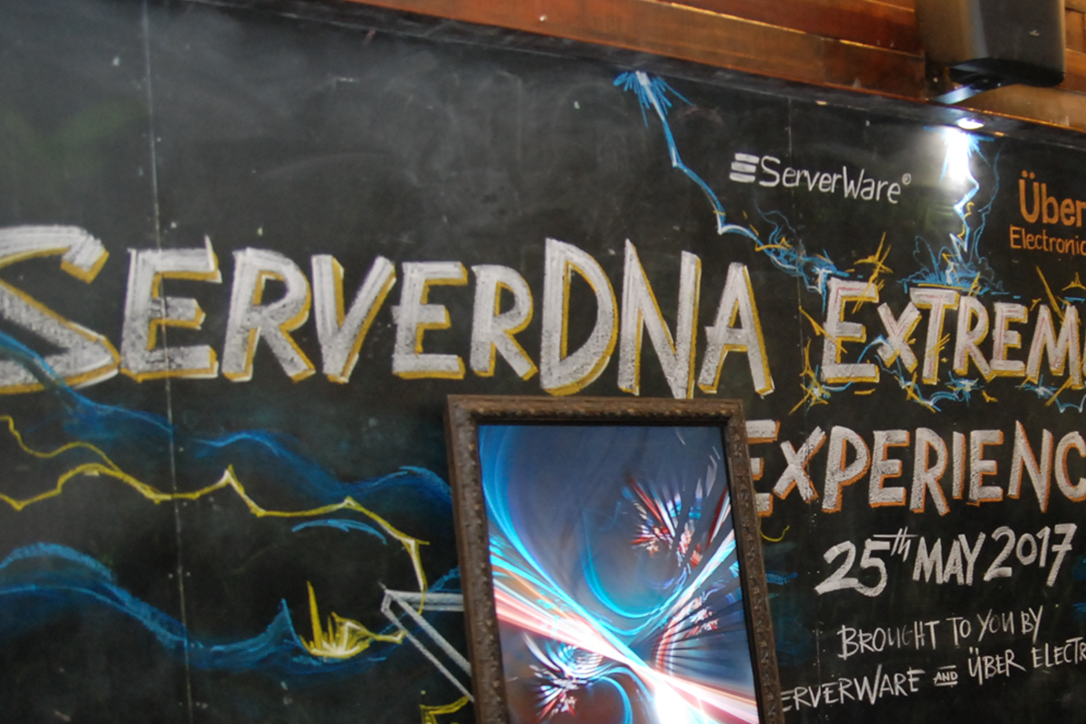

Slide 2
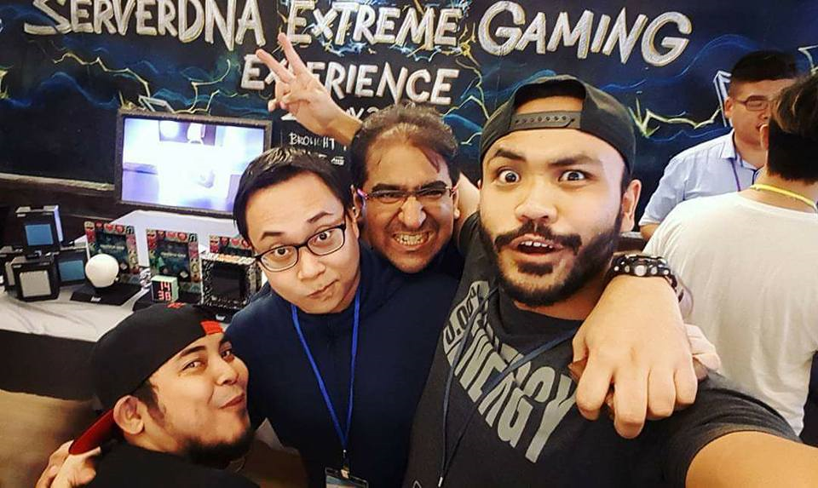
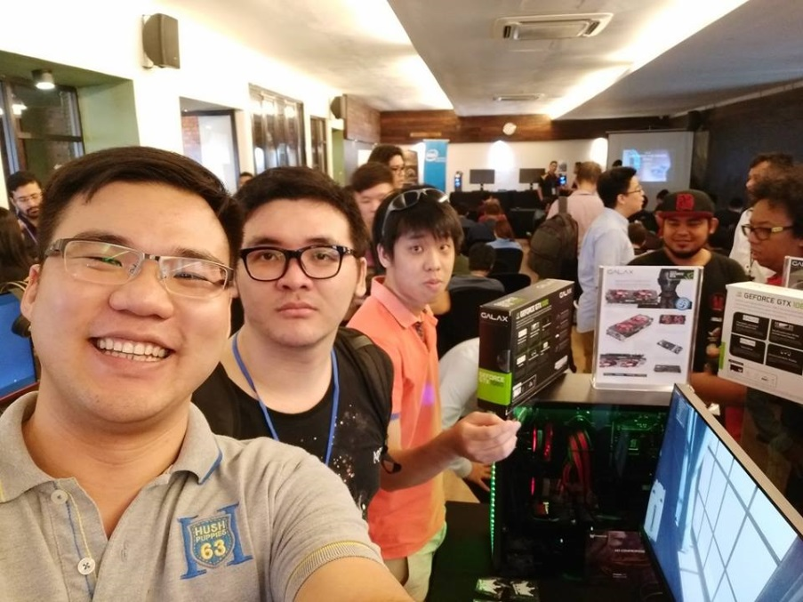
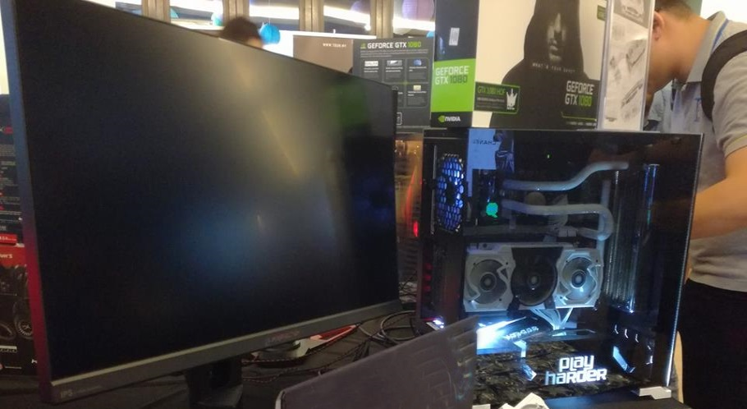
The serverDNA II Event is the single largest
PC Gamers Community Technology Sharing Conference
Where the gamers community meets and network with Technology Owners.

Slide 3
Meet The Technology & Brand Owners Listen & Learn What’s New and Whats’s Hot

Slide 4
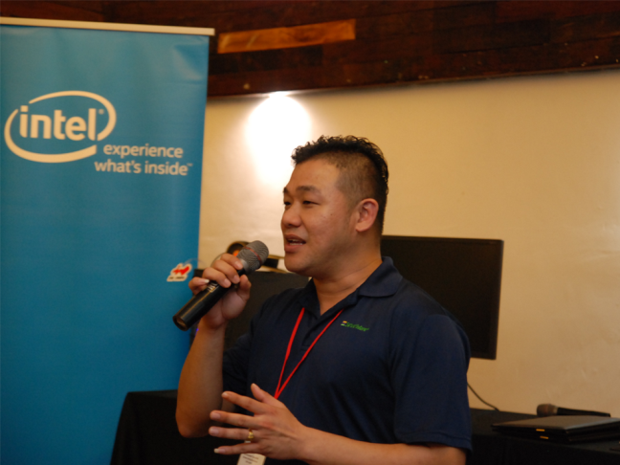
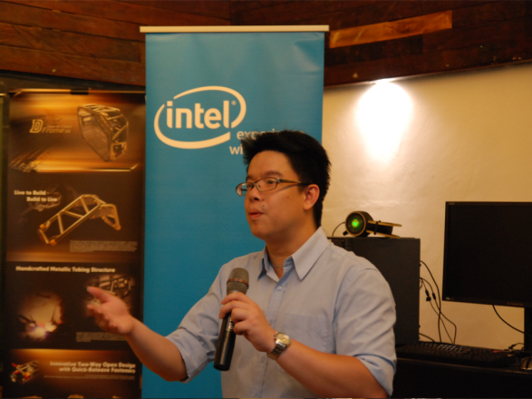
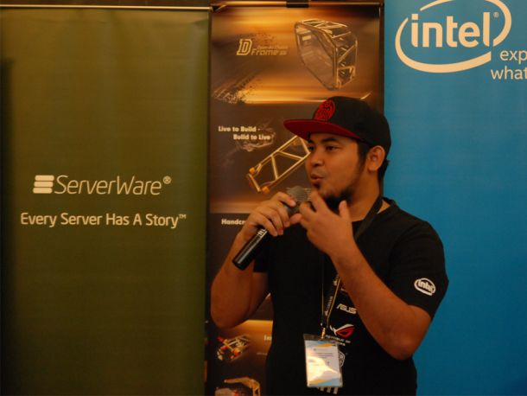
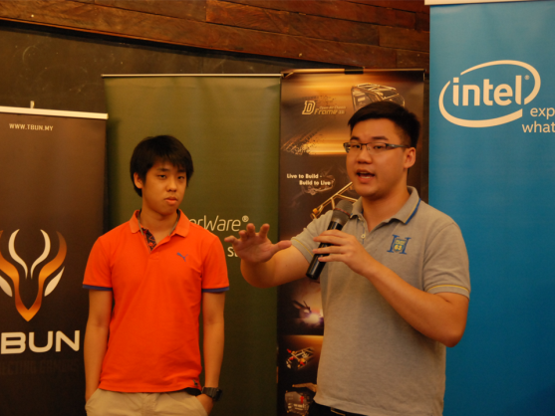
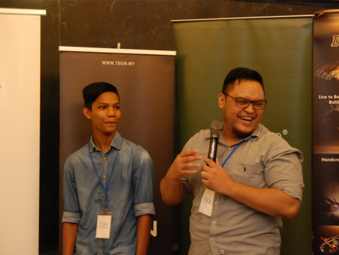
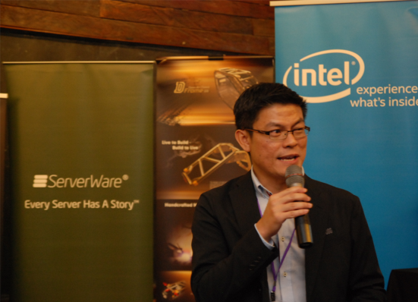
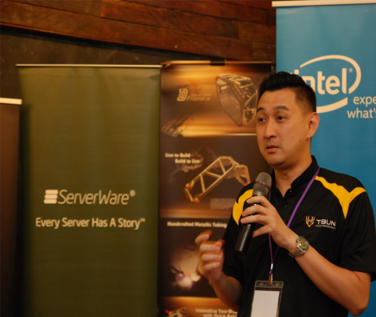
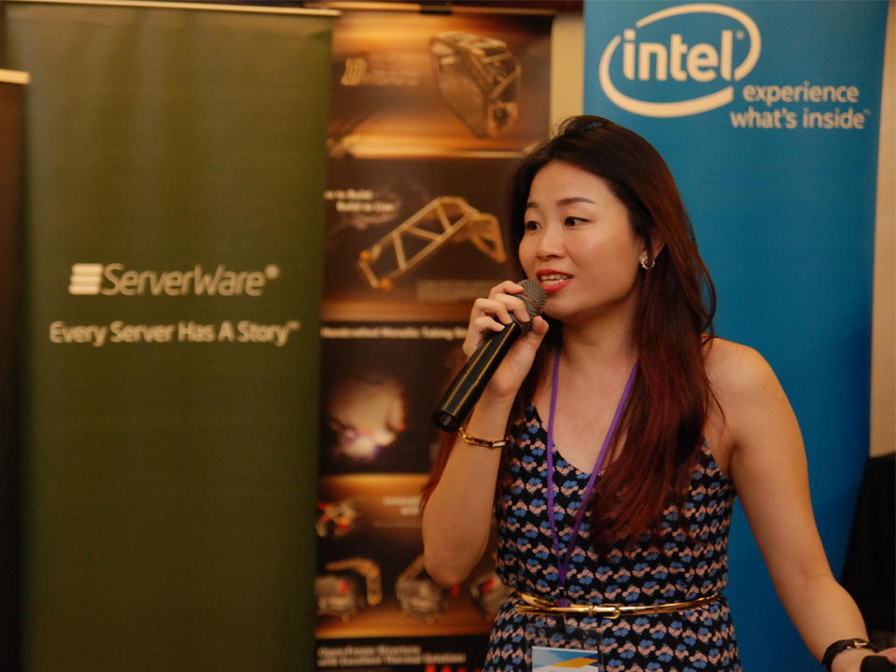
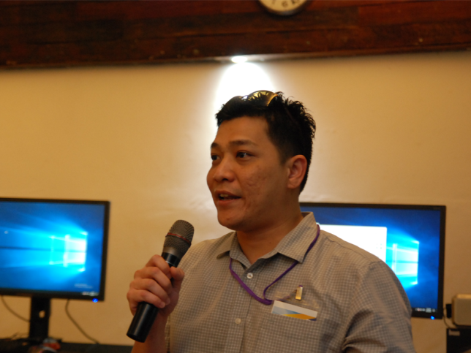
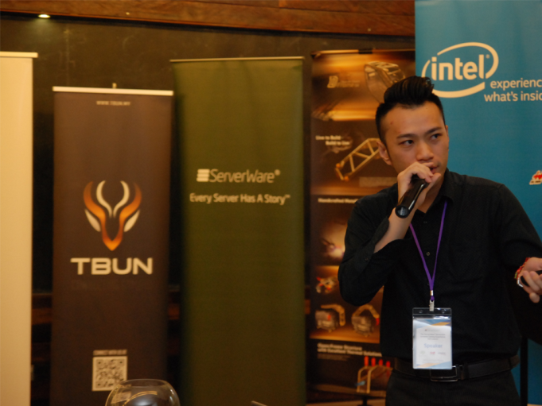
Cross Sharing between Technology Brands, Industry & the Gamers Community

Slide 5
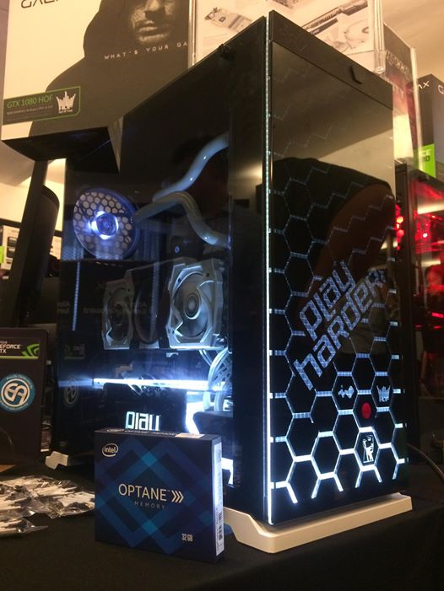
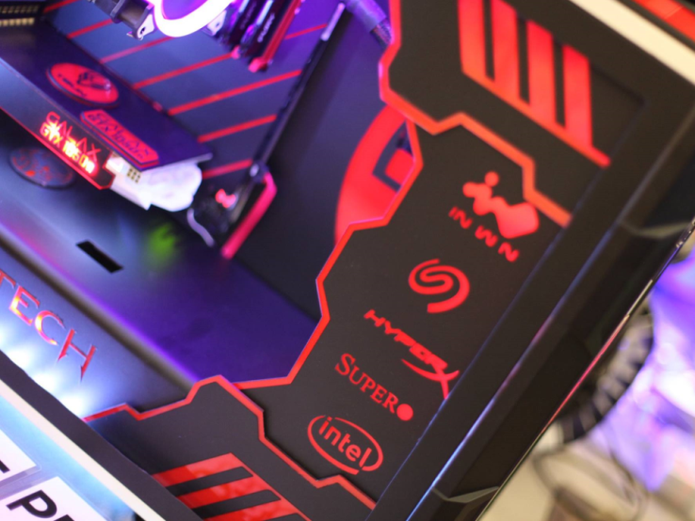
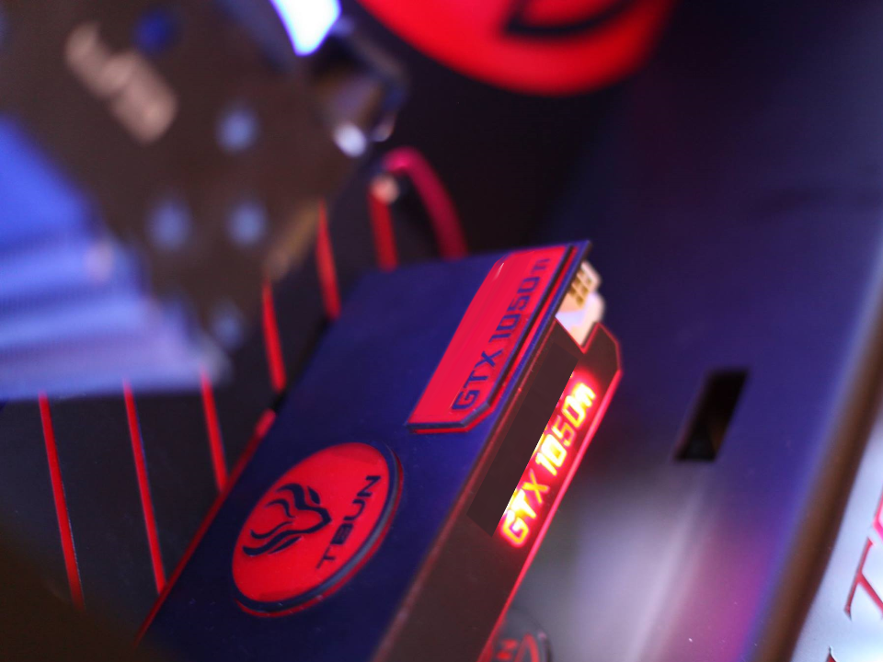
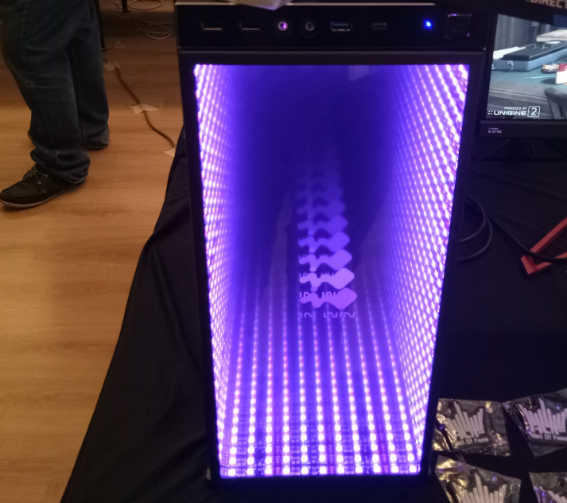
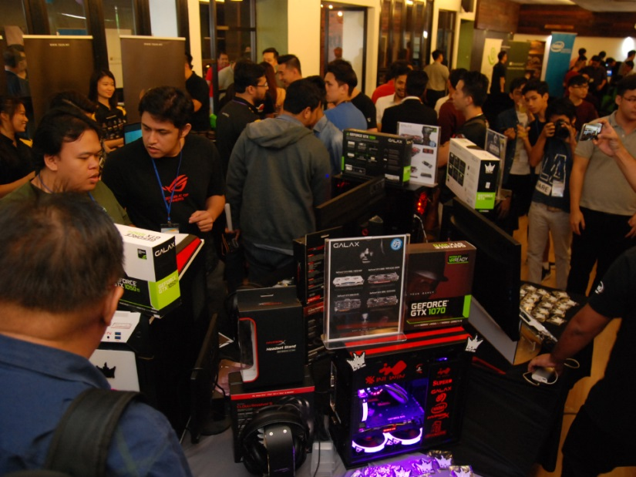
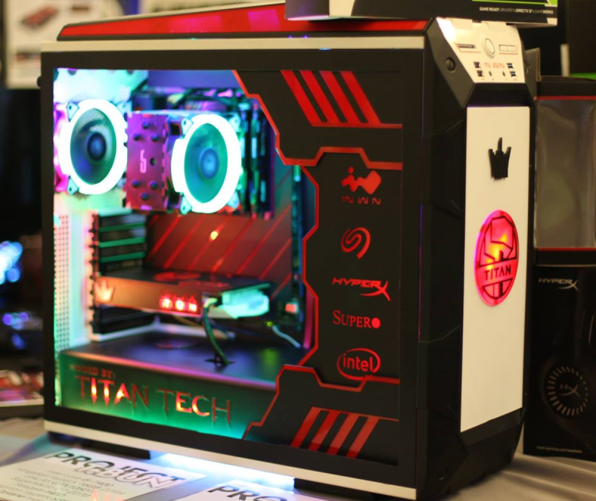
Creativity and Experience Comes Alive with Malaysian Top Modders Showing Their MasterCraftmanship

Slide 6
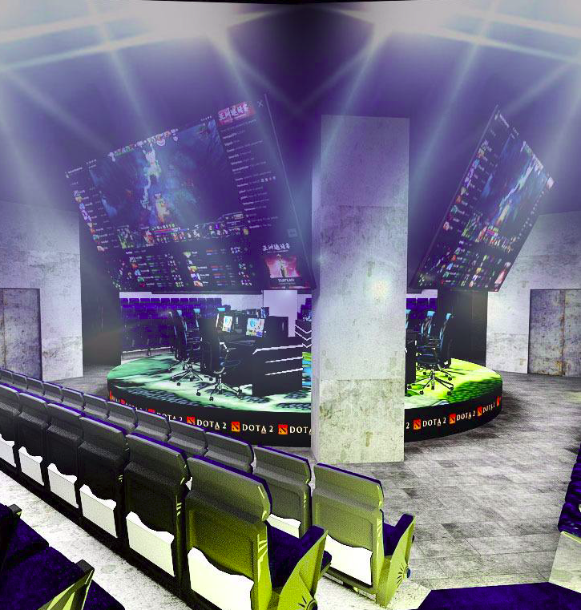
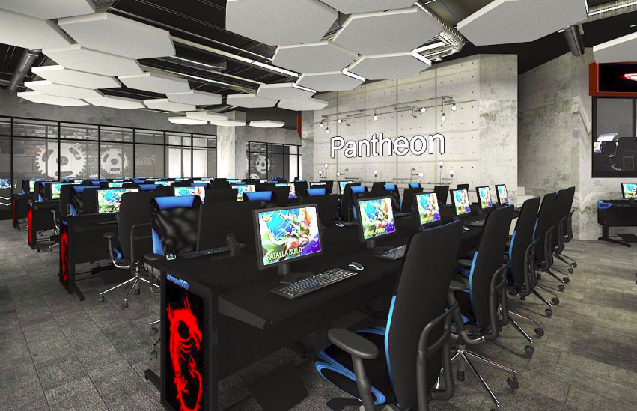
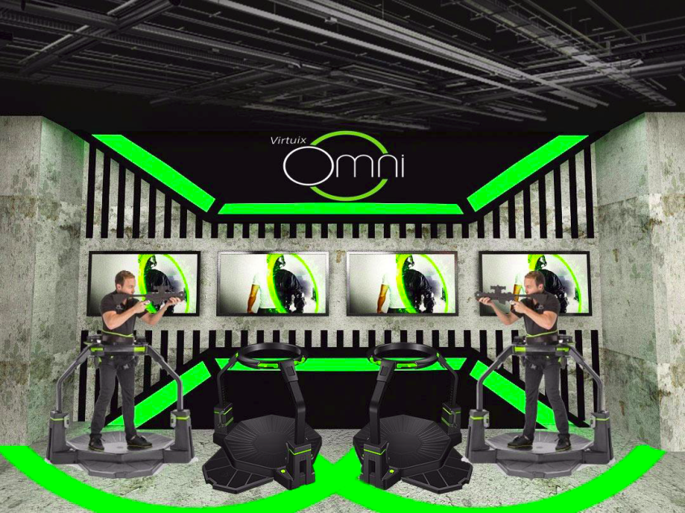
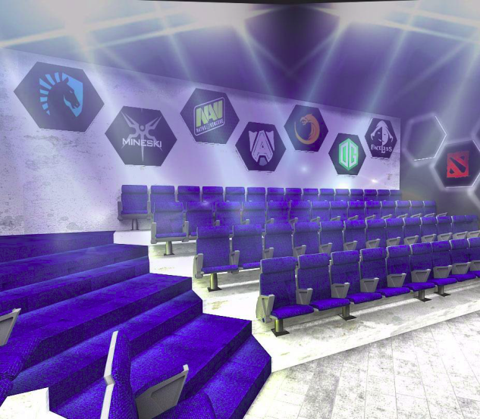
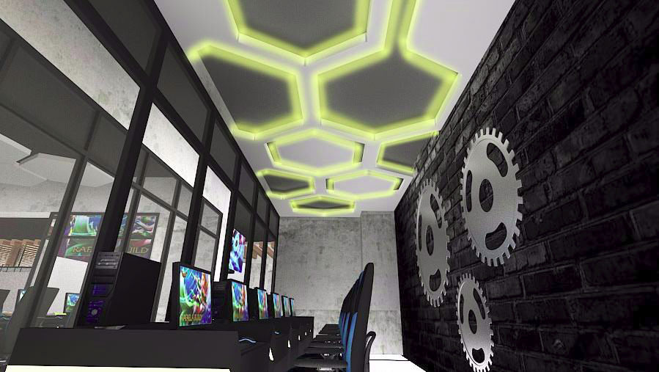
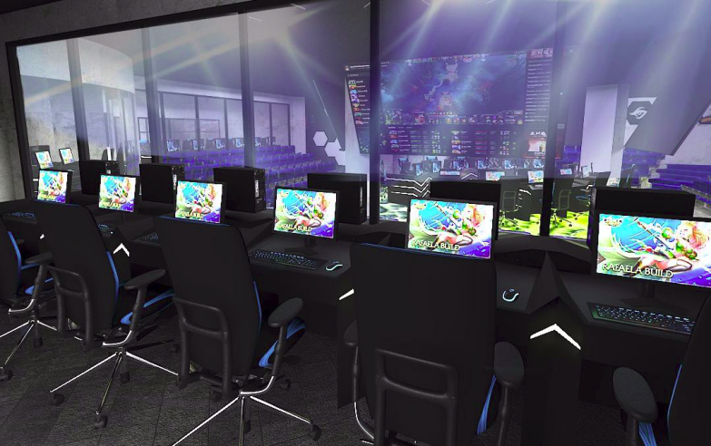
Arena Introductory showcase Learn whats the next generation eSports & gamers experience will be

Slide 7
Challenge
One On One
with your favorite eSports Team
EsPORTS Team Community
Meet & Greet Up close & Personal with the leading Malaysia eSports Team

Slide 8
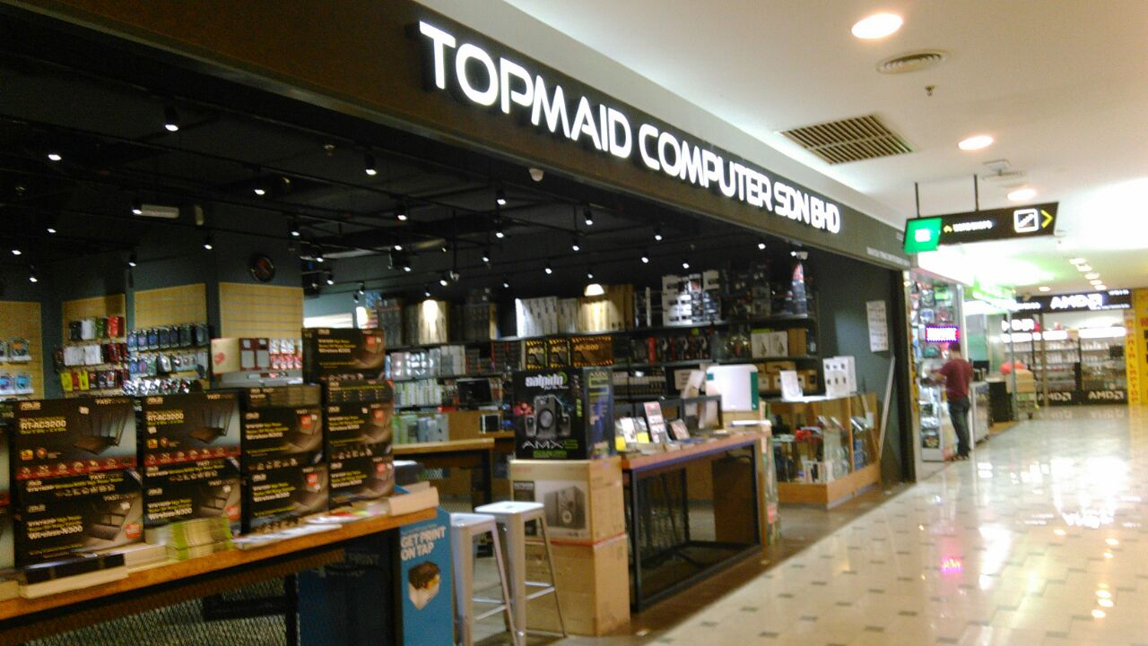
Meet the builders
Get The Best Deal
Custom Build PC Gamers Rig with Markets Top Sellers

Slide 9
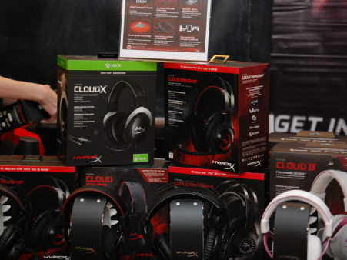
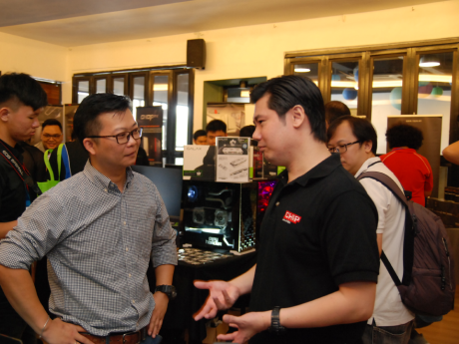
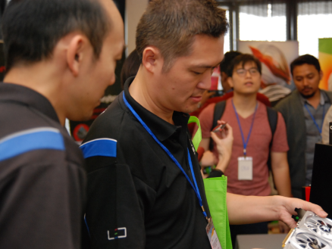
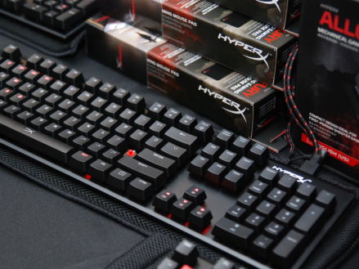
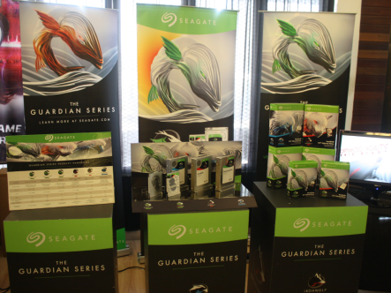
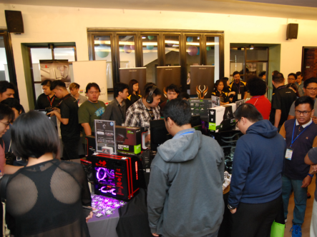
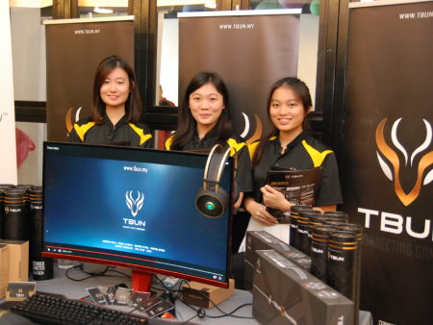
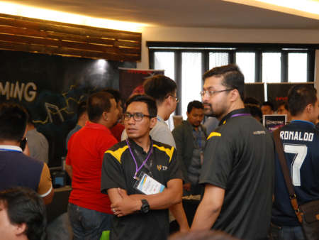
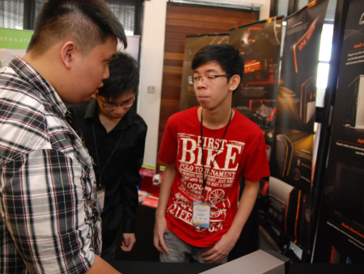
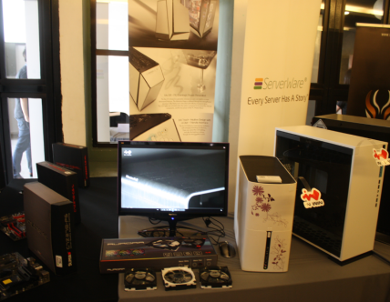
Technology Brand Showcase. Leading the latest Gaming Technology to the community

Slide 10
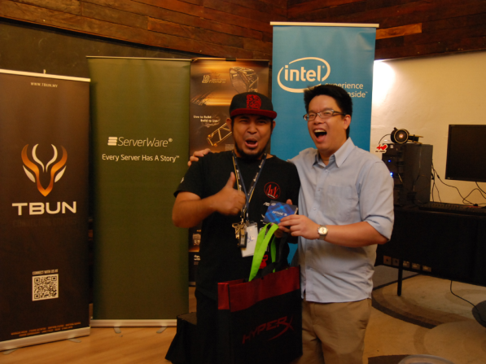
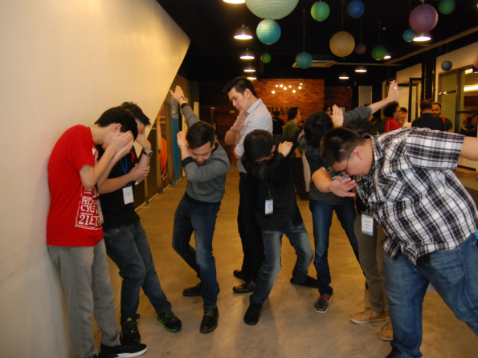
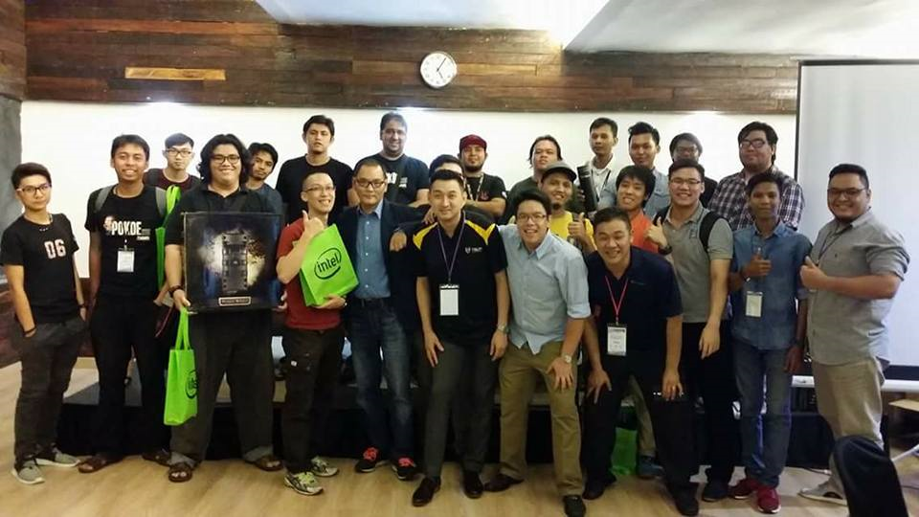
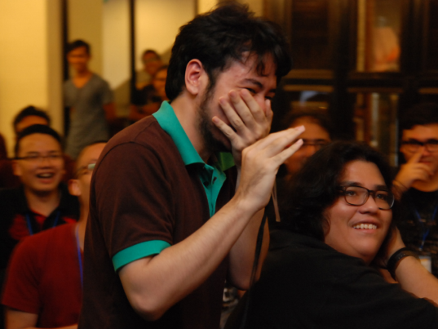
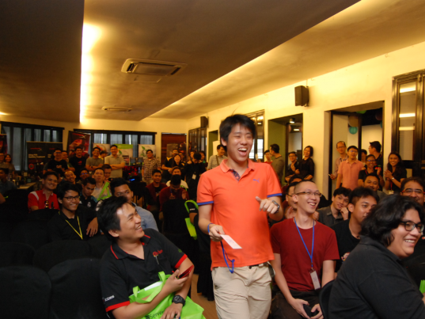
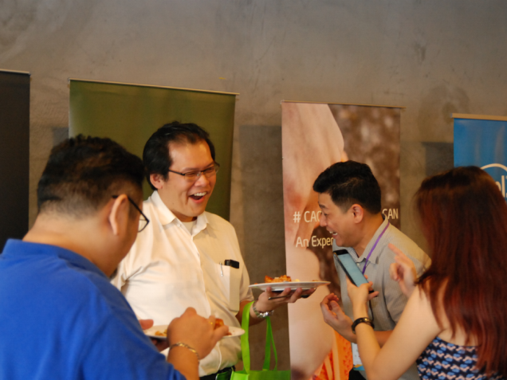
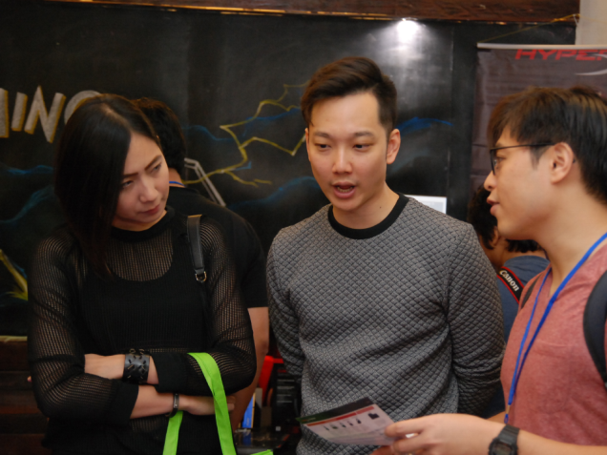
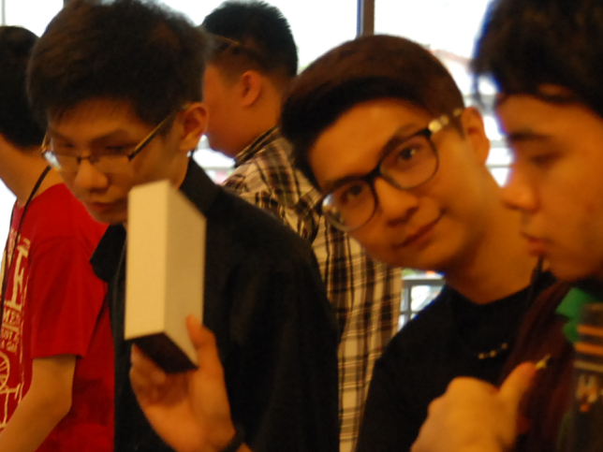
Building Community Growth Through Sharing & Networking

Slide 11
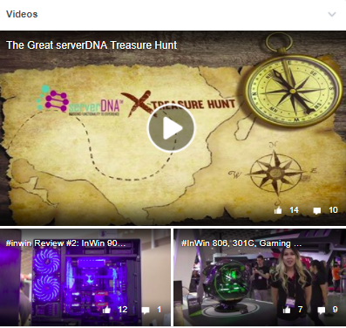
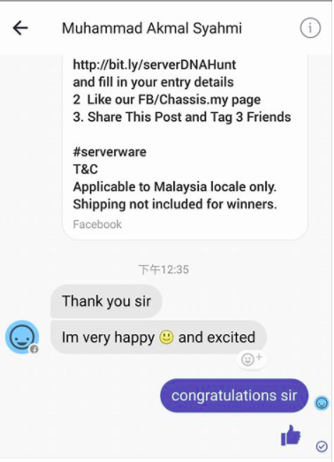
Pre Event Activities
The serverDNA Spot & Win Treasure Hunt Campaign
Bringing the brands and stores to the community online

Slide 12
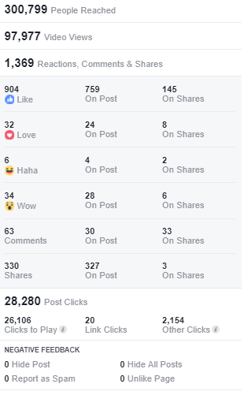
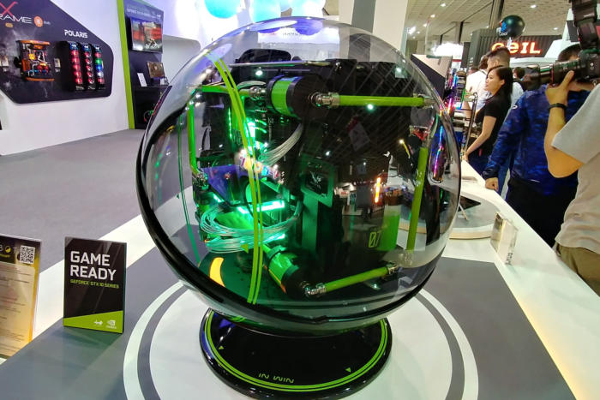
Featured HighLights The InWin WinBot Interactive PC Showcase
First in Malaysia and Asia Pacific

Slide 13
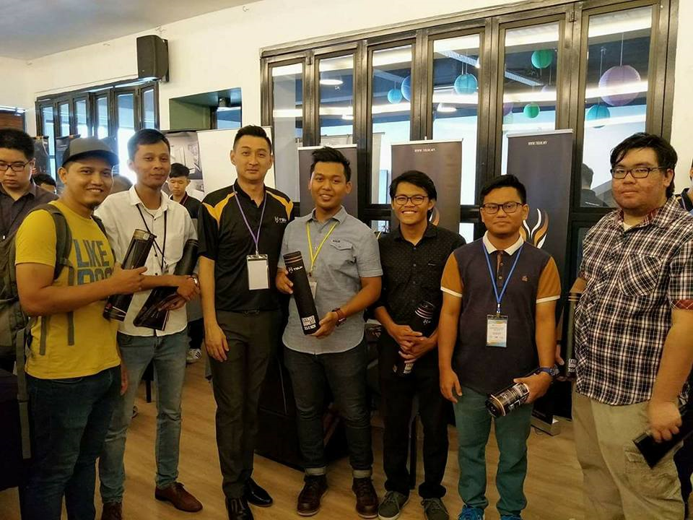
User Happiness Campaign Free Giveaways for user purchases of Brands Products 5 G Shock Watches (TBA) & Approx RM 50-80K Worth of Lucky draws and Auction Bids
serverDNA II Fun & Games
Invitations for the community by the community

Slide 14
Watch & Learn as Master Technologies, Builders and CraftMans Demostrates and Show
Preparation Run Down 6 weeks registration timeline
1st Sept to 12th Oct 2017
Twice Weekly update by SMS reminder
Email Updates for registered Visitors
Twice Weekly write up of products and partners Community Inviting Community

Slide 15
The Fun & Games. Interaction with the community thru lucky draws and auction bids. Win Win Sessions

Slide 16
Location: 1201, Tower 3, Puchong Financial Corporate Centre (PFCC), Jalan Puteri 1/2, Bandar Puteri, Puchong, 47100, Malaysia
The Four Points by Sheraton 12th October 2017
9am-6pm

Slide 17
Venue Capacity:
KPI: 500 Seating PAX
Extension Seating Pax: 600
Standing Pax : 400-600
Total Max Expectation Audience Core Focus Across Board Gaming Community:
1200
7 main Sponsor + 6 Modders Showcase in Ballroom
18 – 20 Foyes All category showcase

Slide 19
830am to 930am – Registration and coffee
900am-10am – Showcase View
10am-1015am – Welcome Message
10.15am 10.30am – Keynote William Lu, 10.30 – 10.45am Unvieling of WinBot
10.45-11.00 - Sontinya Intel
11.00-11.15 - Lucky Draw Session 1
11.15-11.30 - tony fan, SuperO
11.30-11.45 – Seagate Ms Mee Mee
11.45- 11.50 – Grand Lucky draw 1
1150 – 1pm – Lunch, Showcase & Network
1pm 1.15– Samsung
1.15- 1.30 – HyperX
1.30 – 1.45 – Radeon
1.45 – 2.00 – Lucky Draw Session 2
2.00 – 2.15 Brand 2
2.15 – 2.30 Brand 2
2.30-3.30 Grand Lucky Draw 2, tea Break
& Showcase
3.30 – 4.00 Modders Group Forum
4.00- 430 Gamers Enthusiast forum
430- 4.15 Arena Sharing
4.15 – 5.00 Lucky Draw Session 3 Showcase and Network
5.00 – end Auction Bid and Final Lucky Draw
Agenda –
The Gamers Gathering
The Eatery Four Points
9am to 530pm 11th Oct 2017

